Slide 1


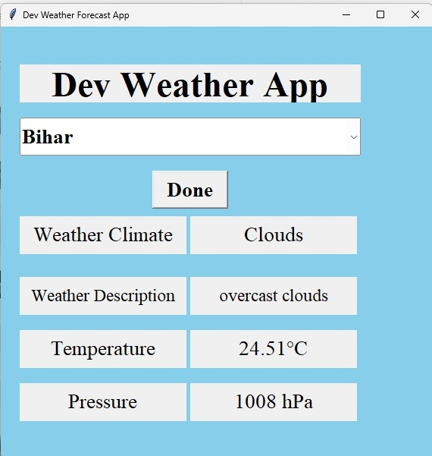

Dev Weather Forecast App
This app provides real-time weather information for cities across India. Users can easily access details like weather conditions, temperature, and pressure with just a few clicks.
By Devashish Biswas
11022210072

Slide 2
Selecting a City
City Selection
Intuitive Interface
Responsive Design
The app features a comprehensive dropdown menu with over 35 cities across India, allowing users to easily find and select their desired location.
The city selection dropdown is prominently displayed, making it simple for users to quickly input their location and retrieve the weather data.
The app's layout is optimized for both desktop and mobile devices, ensuring a seamless user experience regardless of the device being used.

Slide 3

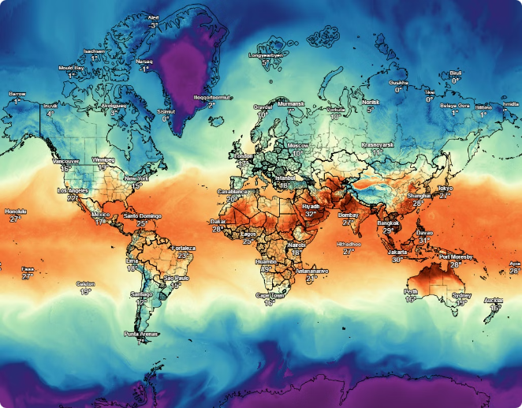
Weather Information
Weather Condition
The app displays the current weather condition, such as "Sunny" or "Cloudy", providing users with a quick overview of the day's weather.
Weather Description
A detailed weather description is also shown, giving users a more comprehensive understanding of the current weather patterns.
Temperature
The app presents the current temperature in Celsius, allowing users to easily gauge the day's temperature.
Atmospheric Pressure
The current atmospheric pressure is displayed in hPa, providing users with additional weather-related information.

Slide 4


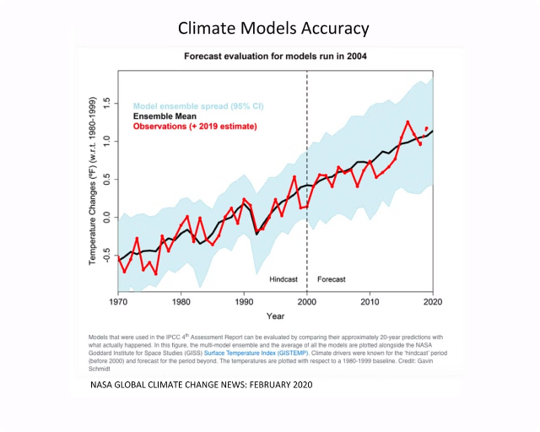
Accurate and Reliable
1
Real-Time Updates
The app retrieves weather data in real-time, ensuring users have access to the most up-to-date information.
2
Trusted Data Source
The weather data is sourced from a reputable provider, guaranteeing the accuracy and reliability of the information displayed.
3
Comprehensive Coverage
The app covers a wide range of cities across India, catering to the diverse needs of users nationwide.

Slide 5

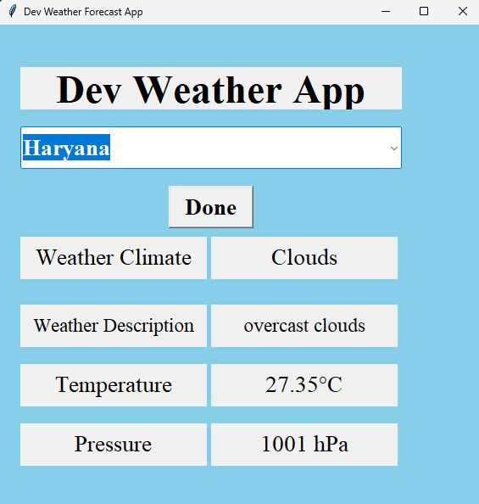


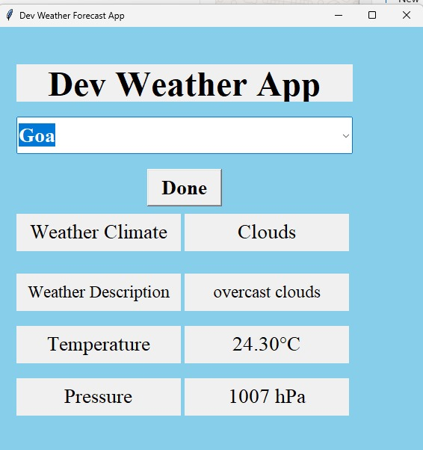

Seamless User Experience
User-Friendly
The app's intuitive design and simple navigation make it easy for users of all technical abilities to access the weather information they need.
Fast and Responsive
The app's efficient data retrieval and processing ensure a smooth and responsive user experience, even on slower internet connections.
Mobile-Optimized
The app's responsive layout and mobile-friendly design allow users to access weather information on-the-go, from any device.

Slide 6

Versatile and Customizable
Multiple Views
Saved Locations
Users can switch between different views, such as a detailed forecast or a simple weather snapshot, to suit their preferences.
Users can save their favorite locations, making it easy to quickly access the weather information for their most frequently visited cities.
1
2
3
Personalization
The app allows users to customize the display, including the units of measurement and the appearance of the weather information.

Slide 7



Helpful Notifications
Weather Alerts
The app can send push notifications to alert users of severe weather conditions, helping them stay prepared and informed.
Forecast Updates
Users can opt-in to receive regular updates on the weather forecast, ensuring they always have the latest information at their fingertips.
Customizable Settings
The notification settings can be tailored to each user's preferences, allowing them to receive only the alerts that are most relevant to them.

Slide 8

Conclusion
The Dev Weather Forecast App is a comprehensive and user-friendly tool that provides accurate and up-to-date weather information for cities across India. With its intuitive design, customizable features, and helpful notifications, the app is an essential companion for anyone who wants to stay informed about the weather.

